Slide 1
Visual Aids

Slide 2

01
Using Visual Aids in Technical Documents
You can enter a subtitle here if you need it

Slide 3
Why use Visual Aids…?
Variety
Concise-ness
Clarity
Access points for readers
Visualiza-tion
Cosmetic appeal

Slide 4

Using Visuals: General Guidelines
A visual should…
Tell a simple story
Reinforce the text, not replace it
Be ethical
Be labelled and placed properly

Slide 5
Types of Visuals
Numerical Tables
Compare exact values
Prose Tables
Organize verbal information
Tables

Slide 6
Types of Visuals
Bar Graphs
Show comparisons
Line Graphs
Show trend(s) over time
Graphs

Slide 7
Types of Visuals
Pie Charts
Show comparisons
Organisation Charts
Show trend(s) over time
Charts
Flow Charts
Steps of a process
Gantt & PERT Charts
Phases of a project
Tree Charts
Parts of idea / concept
Picto-grams
Use icons

Slide 8
Types of Visuals
Illustration
Realistic but simplified view
Cutaway Diagrams
Inside of a device / Parts of a device
Graphic Illustrations
Exploded Diagrams
Assembly of a product
Block Diagrams
Conceptual elements of a process

Slide 9
Types of Visuals
Maps
Visualize position and location of data
Videos
Show procedures
Graphic Illustrations
Photograph
Show exactly what something looks like
Symbols & Icons
Make concepts understand-able for audience

Slide 10
Visuals: Tables
Display dense information (e.g. specifications / comparisons / numbers)
Have rows and columns
Should not be too complex
Should not be overloaded with information
Can sometimes be hard to interpret

Slide 11
Tables: Criteria for Effective Representation
Proper and consistent numbering
Proper titles
Specification of units of measurement
Ample white space
Show omission of information (add “-”)
Indicate continuance of table at the end of the page

Slide 12
Tables: Criteria for Effective Representation
Placement nearest to the text that mentions the table
Introductory sentence
Significance
Centered alignment
Citation of data sources

Slide 13
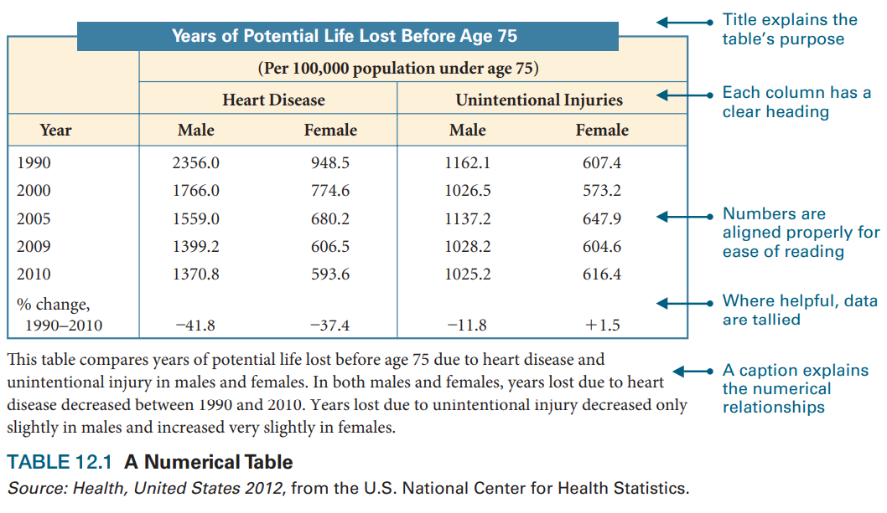

Slide 14
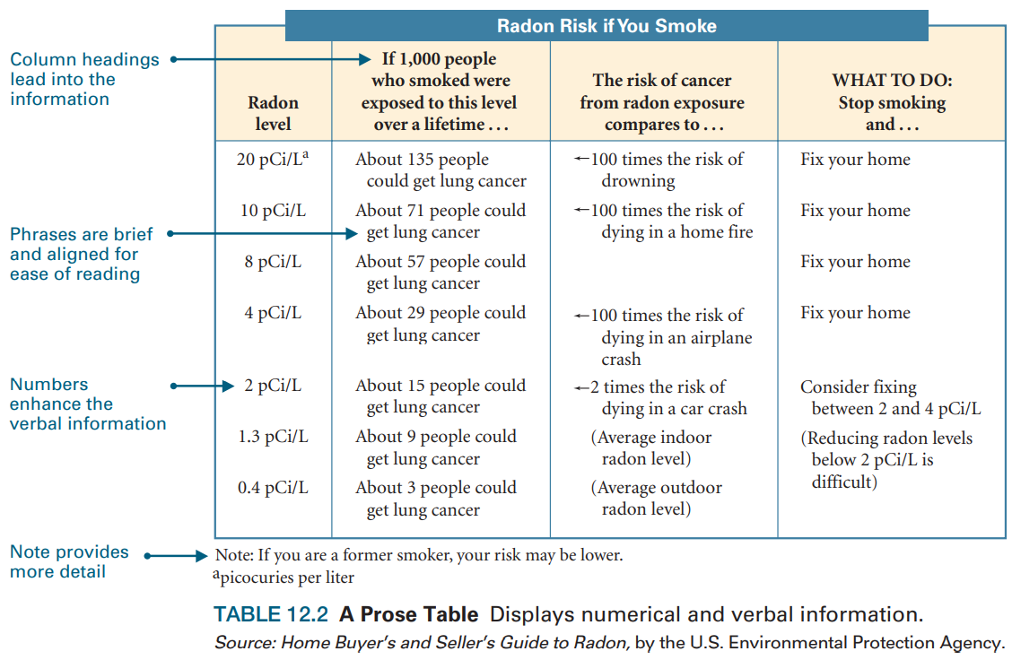

Slide 15
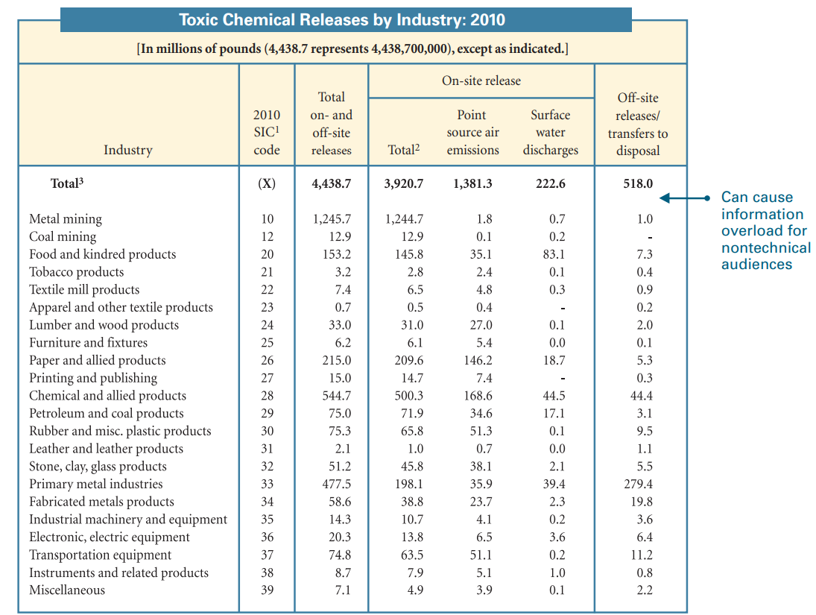

Slide 16
Graphs: Bar Graphs
Bar Graphs
Easy to understand
Show discrete comparisons
Bars represent specific quantities
Focus on one value or changes in values over time

Slide 17

Simple Bar Graph
Grouped Bar Graph
Horizontal Bar Graph
Stacked Bar Graph
One trend
Multiple trends
Horizontal bars
Contribution of each data set to the whole

Slide 18
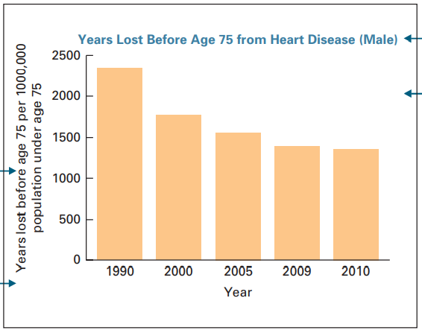
Simple Bar Graph
Grouped Bar Graph
Horizontal Bar Graph
Stacked Bar Graph
One trend
Multiple trends
Horizontal bars
Contribution of each data set to the whole

Slide 19
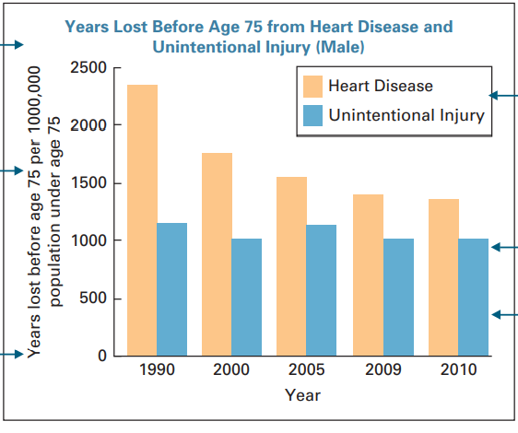
Simple Bar Graph
Grouped Bar Graph
Horizontal Bar Graph
Stacked Bar Graph
One trend
Multiple trends
Horizontal bars
Contribution of each data set to the whole

Slide 20
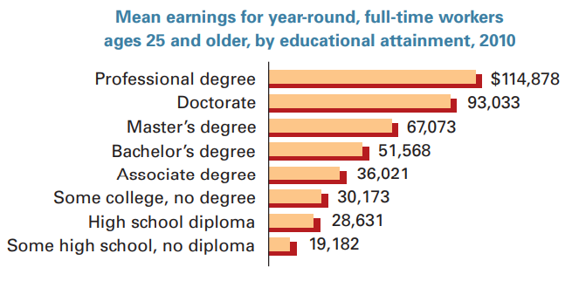
Simple Bar Graph
Grouped Bar Graph
Horizontal Bar Graph
Stacked Bar Graph
One trend
Multiple trends
Horizontal bars
Contribution of each data set to the whole

Slide 21
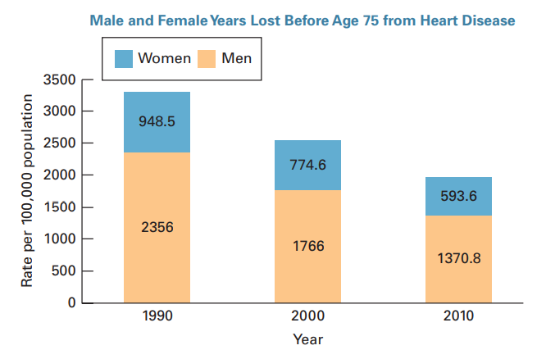
Simple Bar Graph
Grouped Bar Graph
Horizontal Bar Graph
Stacked Bar Graph
One trend
Multiple trends
Horizontal bars
Contribution of each data set to the whole

Slide 22
Graphs: Line Graphs
Line Graphs
More data points than bar graphs
Easier interpretation
Useful when exact quantities are not as important as the big picture
Useful for large data sets

Slide 23
Simple Line Graph
Multiple Bar Graph
Band / Area Graph
Multiple Bands Graph
One trend
Multiple trends
Shaded bands beneath the plot lines
Multiple shaded bands

Slide 24
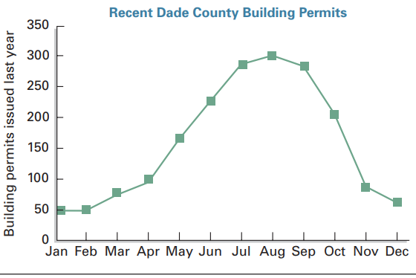
Simple Line Graph
Multiple Bar Graph
Band / Area Graph
Multiple Bands Graph
One trend
Multiple trends
Shaded bands beneath the plot lines
Multiple shaded bands

Slide 25
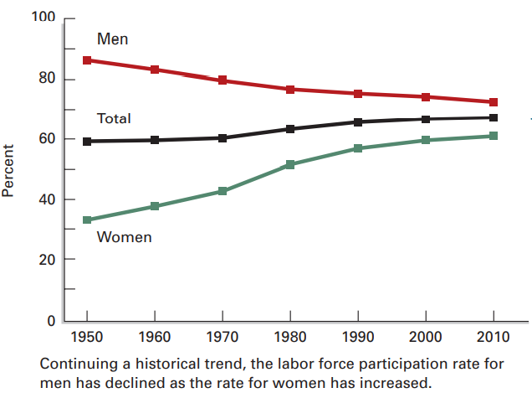
Simple Line Graph
Multiple Bar Graph
Band / Area Graph
Multiple Bands Graph
One trend
Multiple trends
Shaded bands beneath the plot lines
Multiple shaded bands

Slide 26
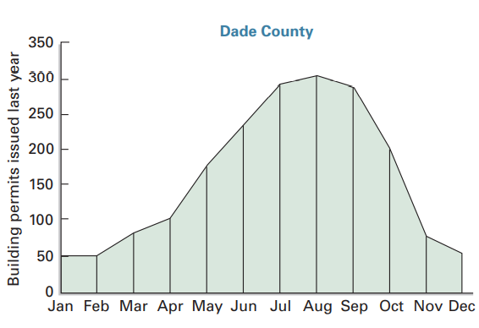
Simple Line Graph
Multiple Bar Graph
Band / Area Graph
Multiple Bands Graph
One trend
Multiple trends
Shaded bands beneath the plot lines
Multiple shaded bands

Slide 27
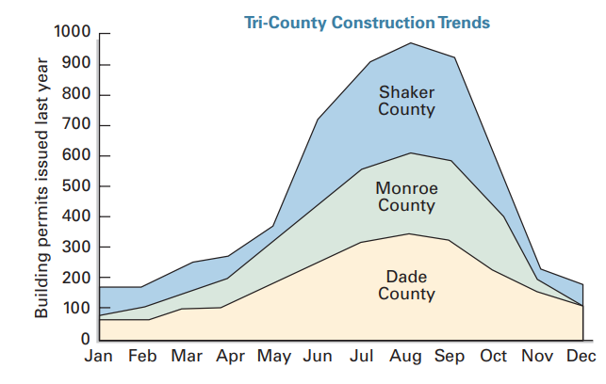
Simple Line Graph
Multiple Bar Graph
Band / Area Graph
Multiple Bands Graph
One trend
Multiple trends
Shaded bands beneath the plot lines
Multiple shaded bands

Slide 28
Charts
Charts
Display relationships (Quantitative or Cause-Effect)
Not plotted on a coordinate system

Slide 29
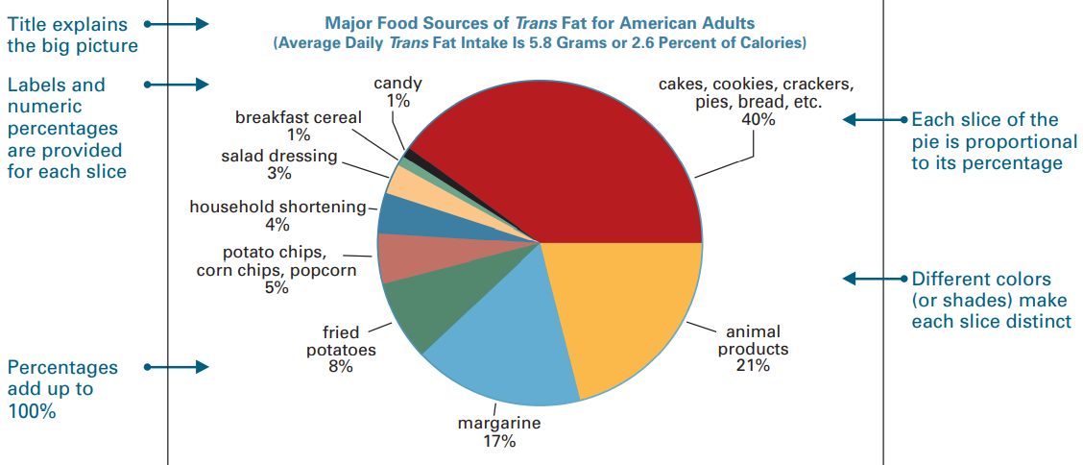
Simple Pie Chart

Slide 30
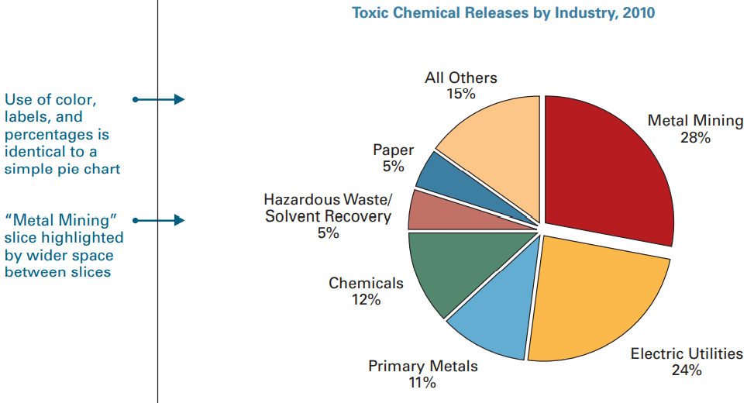
Exploded Pie Chart: Helps Emphasize Significant Data

Slide 31
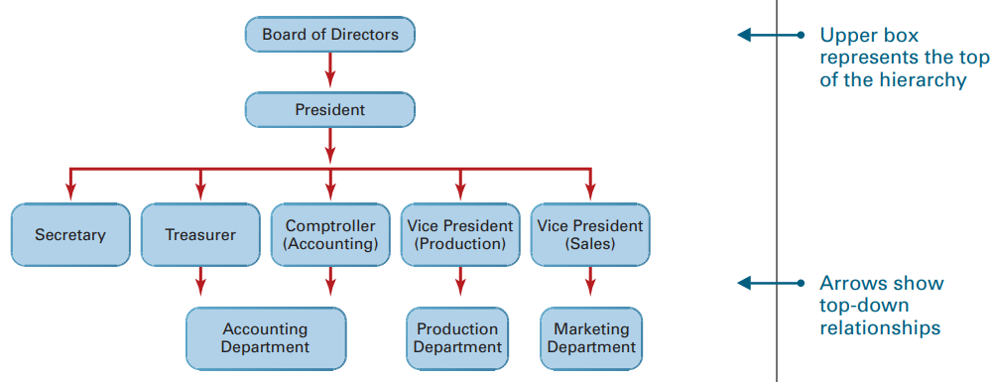
Charts: Organisational Charts

Slide 32
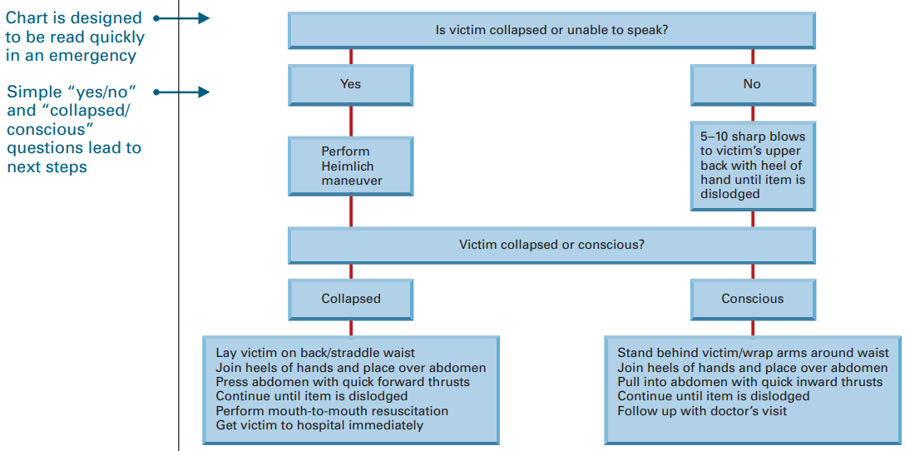
Flow Chart: Sequence of Events, Activities, Steps, Decisions

Slide 33
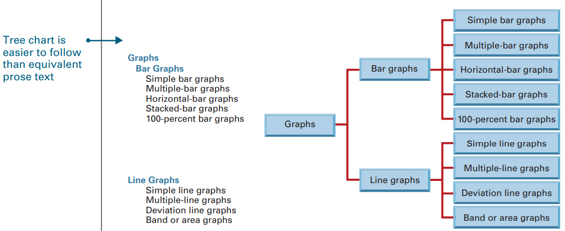
Tree Chart: Relationships between Items (Categorization)

Slide 34
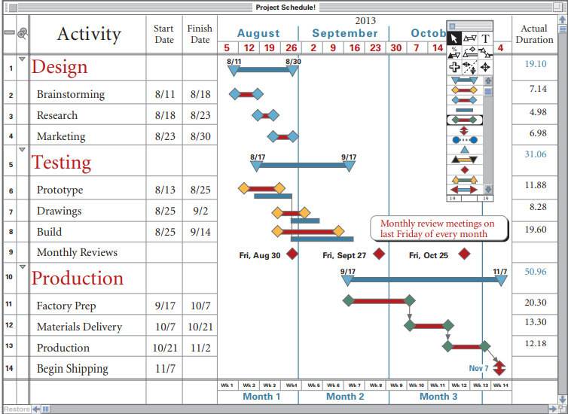
Gantt
Chart:
Phases of a Project

Slide 35
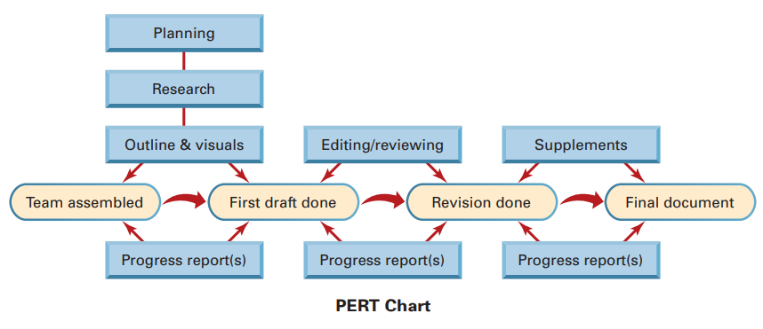
PERT Chart: Key activities (Rectangles) & Milestones (Ovals)

Slide 36
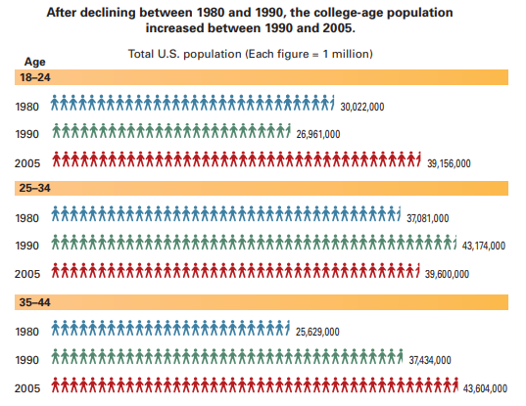
Pictogram

Slide 37
Graphic Illustrations
Graphic Illustrations
When pictures are more effective than words
Used when visualization is vital to understanding
Used when data cannot be shown via tables / graphs / charts

Slide 38
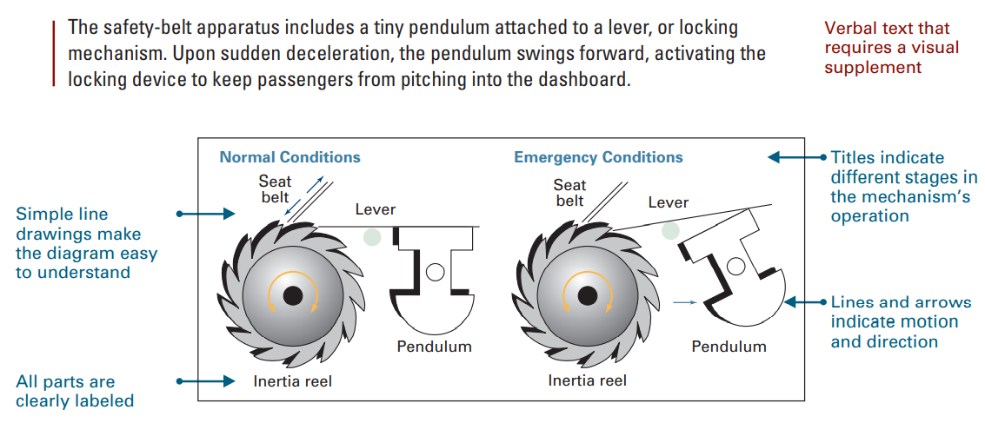
Diagram: Safety-belt locking mechanism

Slide 39
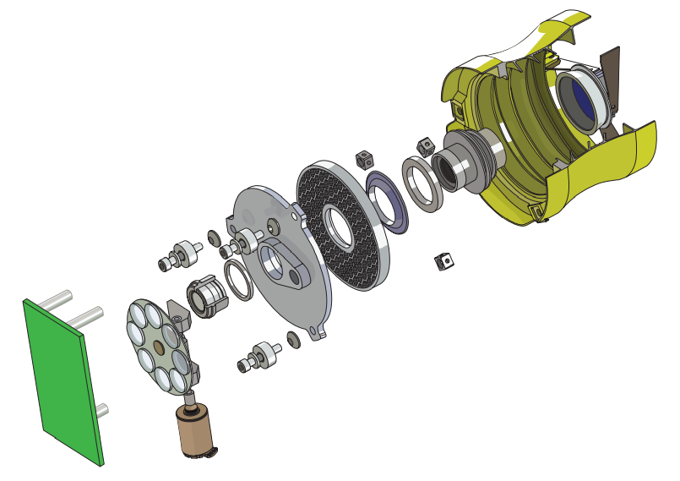
Exploded Diagram: Imaging instruments used in NASA

Slide 40
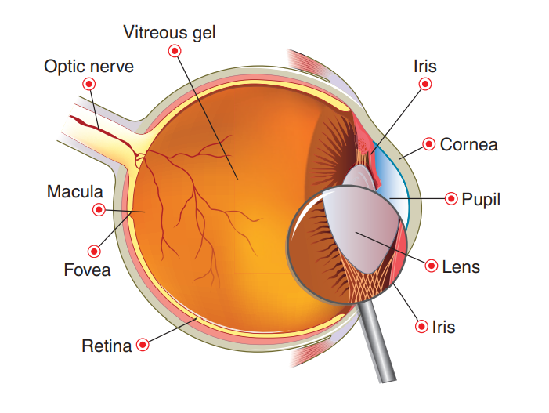
Cutaway Diagram: What’s inside the human eye?

Slide 41
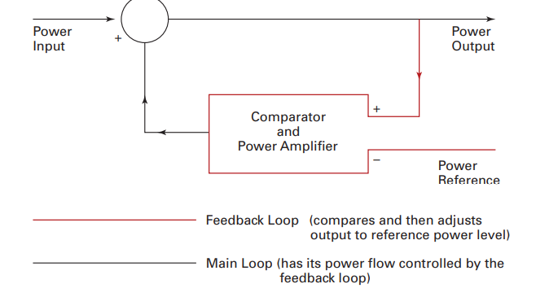
Block Diagram: Concept of Feedback Mechanism

Slide 42
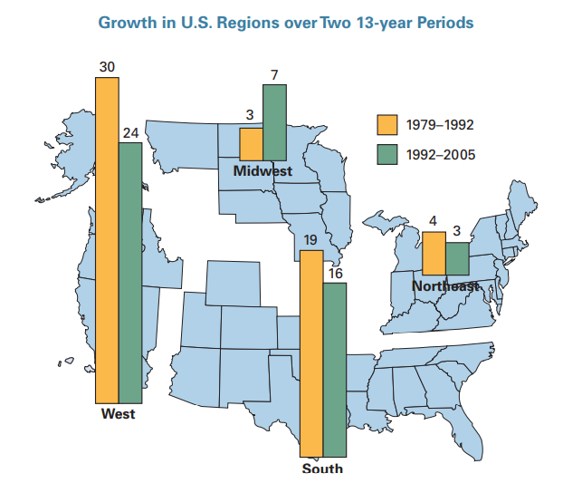
Maps: Geographic Distribution of Data

Slide 43
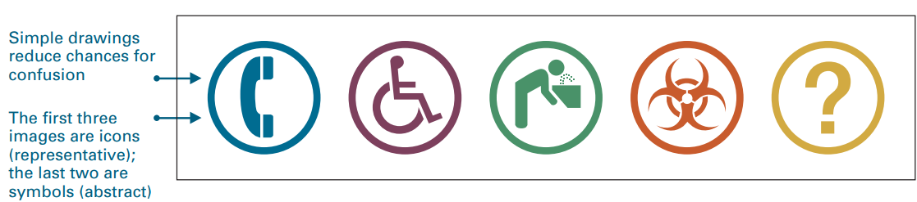
Symbols & Icons

Slide 44
Symbols & Icons: Considerations
Keep human icons simple
Use hand signals carefully
Use internationally accepted symbols and icons
Avoid culture-specific icons
Avoid religious symbols
Avoid animal symbols and mascots

Slide 45
Should visuals aids be colored…?

Slide 46
Drawbacks of Colored Visual Aids
Might be distracting
Might go out-of-style in time
Increase production costs
Require more disk space
Lose their value if/when printed in Black&White

